Slide 1
SOLID Principles

Slide 2
What is SOLID
SOLID are five basic architecture design principles.
SOLID principles help creating good software architecture
SOLID stands for:
S stands for SRP (Single responsibility principle)
O stands for OCP (Open closed principle)
L stands for LSP (Liskov substitution principle)
I stands for ISP ( Interface segregation principle)
D stands for DIP ( Dependency inversion principle)

Slide 3
Single responsibility principle
Lets say that we want to design online shopping website.
EASY!

Slide 4
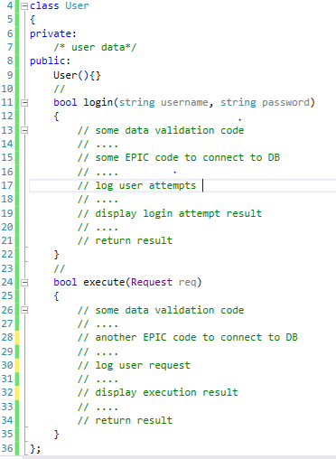
Single responsibility principle

Slide 5
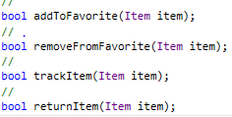
Single responsibility principle

Slide 6
Single responsibility principle
So tomorrow if I want to change:
The logger from console logger to file logger
The display mechanism
The DB
Obviously I need to change in the User class.

Slide 7
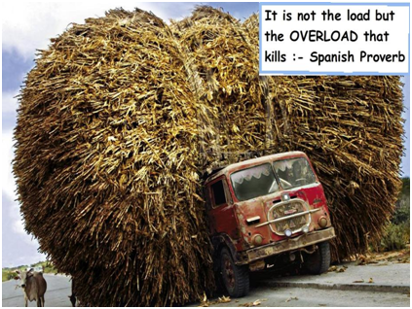
Single responsibility principle
It’s like if “JOHN” has a problem why do I need to check “BOB”.

Slide 8
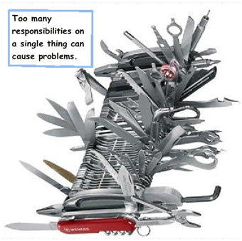
Single responsibility principle
If one of them needs to be changed the whole set needs to be disturbed.

Slide 9
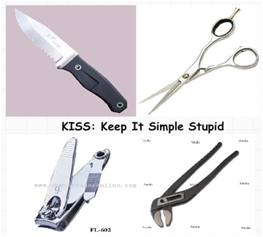
Single responsibility principle
But if we can have each of those items separated its simple, easy to maintain and one change does not affect the other.

Slide 10
Single responsibility principle
But if we can have each of those items separated its simple, easy to maintain and one change does not affect the other.

Slide 11
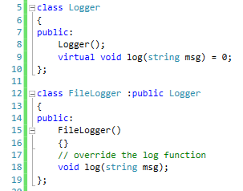
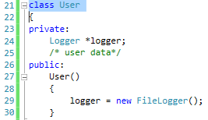
Single responsibility principle

Slide 12
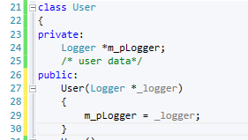

Single responsibility principle
Abstraction is the dark magic of programming

Slide 13
Single responsibility principle
Abstraction is the dark magic of programming

Slide 14
Open closed principle
Lets say we have two types of user: Gold and Silver.
Depending on the user type we calculate a certain discount.

Slide 15
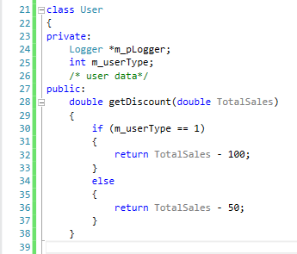
Open closed principle
The “getDiscount” function returns discount accordingly. 1 for Gold customer and 2 for Silver customer.
Guess, what’s the problem with this code?

Slide 16
Open closed principle
The problem is if we add a new user type we need to go and add one more “IF” condition in the “getDiscount” function, in other words we need to change the user class.

Slide 17
Open closed principle
If we are changing the User class again and again, we need to ensure that the previous conditions and functionalities are tested again.
In other words we are “MODIFYING” the current User code for every change and every time we modify we need to ensure that all the previous functionalities and connected objects are working as before.
How about rather than “MODIFYING” we go for “EXTENSION”. In other words every time a new customer type needs to be added we create a new class as shown in the below. So whatever is the current code they are untouched and we just need to test and check the new classes.

Slide 18
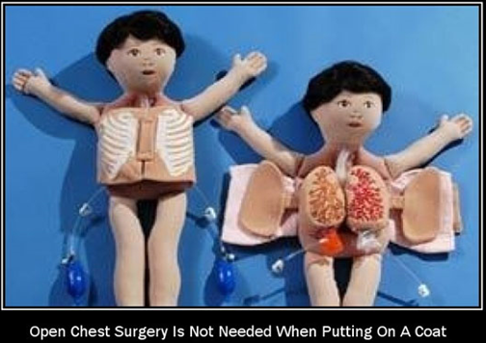
Open closed principle

Slide 19
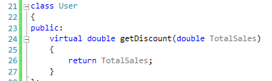
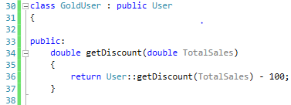
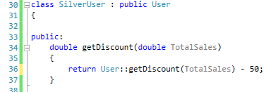
Open closed principle

